Slide 1




Azure Databricks with R: Deep Dive Bryan Cafferky Data Solutions Enabler

Slide 2


Scale Up vs. Scale Out
Scale Up
Scale Out

Slide 3

Scale Up vs. Scale Out
Scale Out

Slide 4
The Apache Hadoop Project

Slide 5
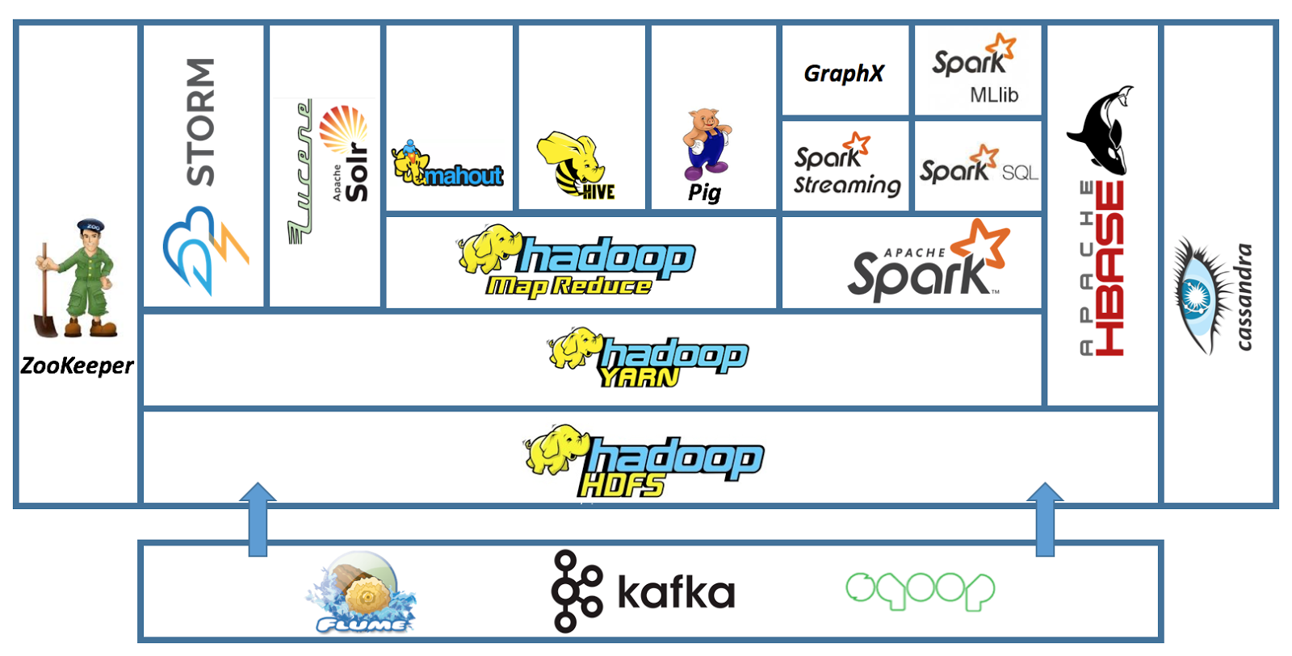
The Apache Hadoop Ecosystem
Scala, Java, Python, R
In Memory MPP
NoSQL
Storage
Streaming
Distributed
System
Coordination
Full Text
Search
ETL
Machine Learning
SQL
Real Time
H
a
d
o
o
p
B
A
T
C
H
Queuing Service
Move Data to/From SQL Databases
Streaming

Slide 6
Apache Spark
An unified, open source, parallel, data processing framework for Big Data Analytics
R Language is not Supported by Spark (directly)
Spark SQL
Interactive Queries
Spark MLlib
Machine Learning
Spark Streaming
Stream processing
GraphX
Graph Computation
Spark Unifies:
Batch Processing
Interactive SQL
Real-time processing
Machine Learning
Deep Learning
Graph Processing
Spark Core Engine
Yarn
Mesos
Standalone Scheduler
Spark MLlib
Machine Learning
Spark Structured Streaming
Stream processing
R Packages SparkR and SparklyR Wrap the Spark API

Slide 7
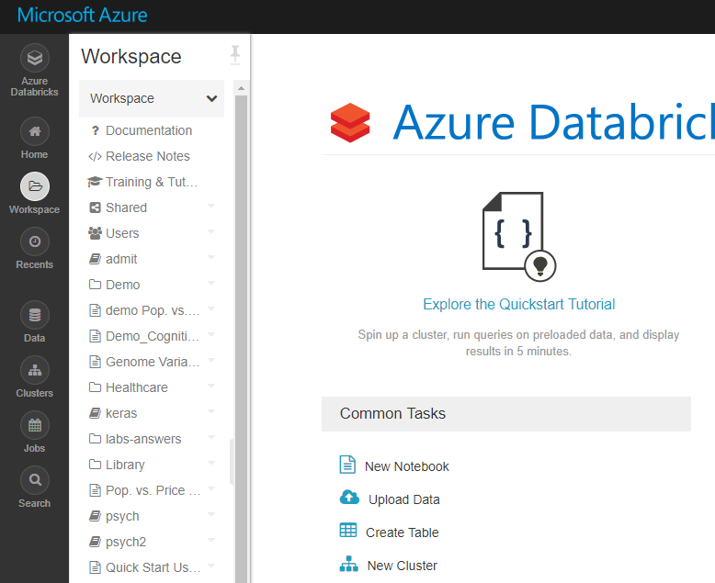
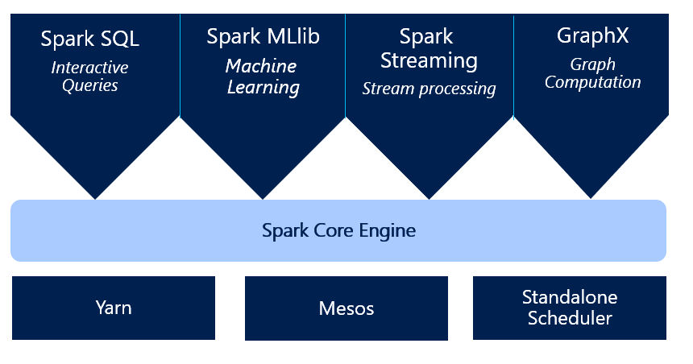
Azure Databricks R Language Deep Dive

Slide 8




Azure
Easy
Cluster Creation
Scheduling
Big Data
Databricks IDE
Notebooks
Security
Collaboration

Slide 9
General Spark Cluster Architecture
R Code Must Be Copied to Every Node
Driver Program SparkContext
‘Driver’ runs the user’s ‘main’ function and executes the various parallel operations on the worker nodes.
The results of the operations are collected by the driver
The worker nodes read and write data from/to Data Sources including HDFS.
Worker node also cache transformed data in memory as RDDs (Resilient Data Sets).
Worker nodes and the Driver Node execute as VMs in public clouds (AWS, Google and Azure).
Cluster Manager
Worker Node
Worker Node
Worker Node
Cache
Cache
Cache
Task
Task
Task
Nodes Run JVM
Data Sources (HDFS, SQL, NoSQL, …)

Slide 10
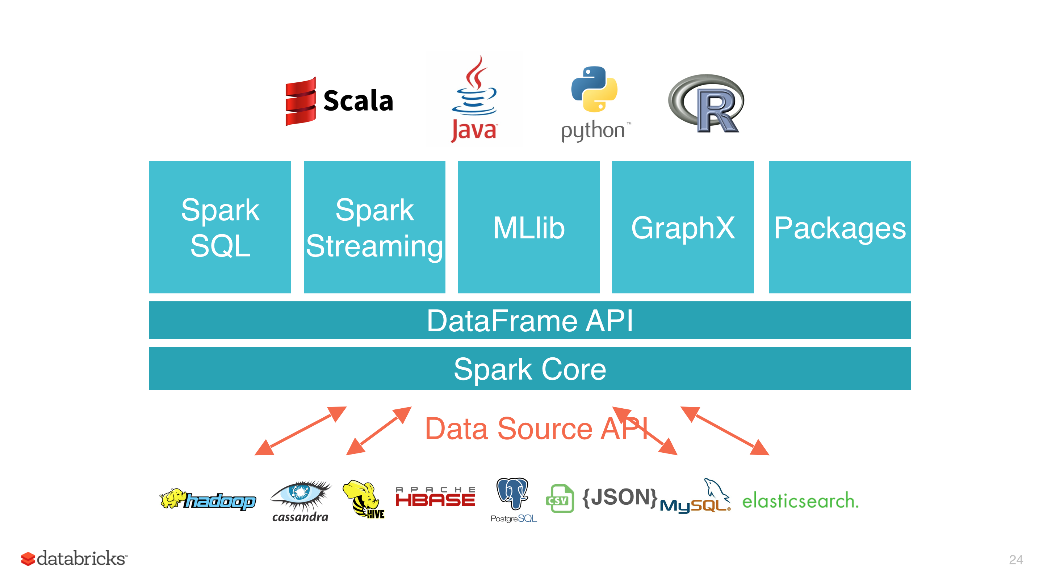
Azure Databricks R Language Deep Dive

Slide 11
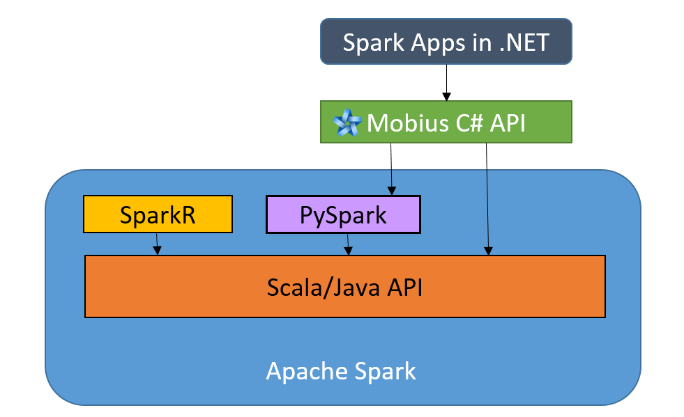
Apache Spark API
https://databricks.com/blog/2016/08/03/developing-apache-spark-applications-in-net-using-mobius.html

Slide 12
What is an API?
Application Programming Interface
Exposes a Service so it Can Be Called
Provides a Standard Way to Call the Exposed Service
Implementation Details are Hidden from the Calling Program
The Calling Program Can Hide the API Details from the User

Slide 13
What Does a Spark API Do?
Load Data Using of Spark
Read and Manipulate Data in Spark
Push Processing to the Spark Cluster Nodes
Do Work on the Head Node
Retain the Feel and Paradigm of the Calling Language
What Kind of Processing?
Data Wrangling or ML Training?

Slide 14
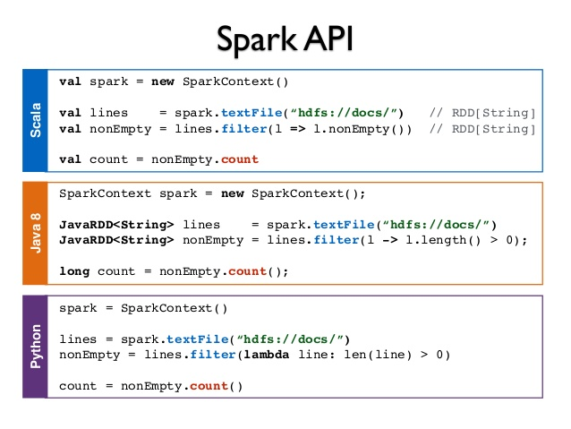
Obfuscating Spark with the a Language API
https://www.slideshare.net/frodriguezolivera/apache-spark-streaming

Slide 15
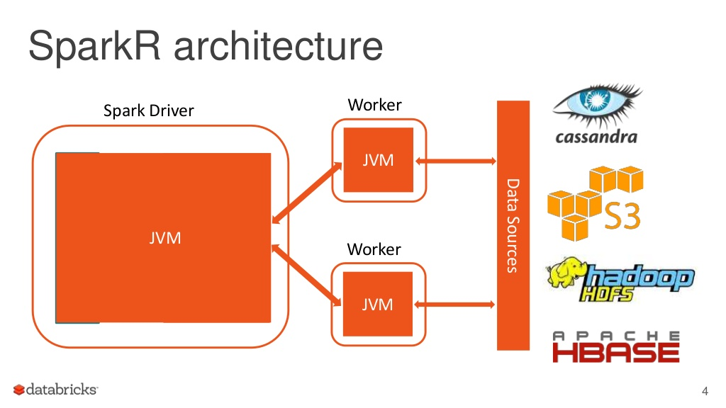
Apache Spark API
https://www.slideshare.net/databricks/parallelizing-existing-r-packages-with-sparkr

Slide 16
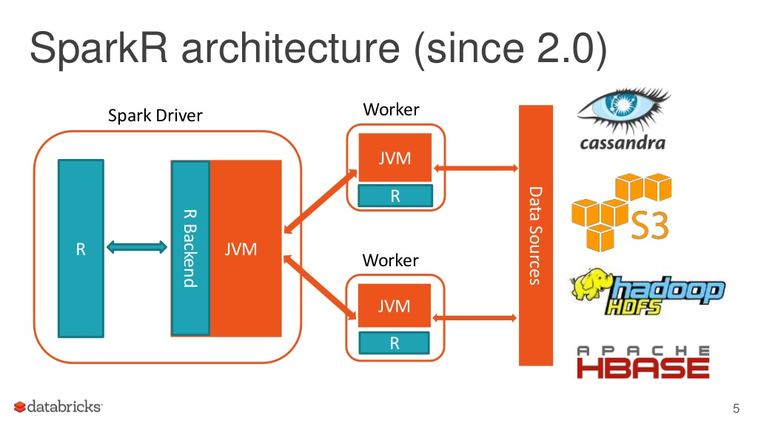
Apache Spark API
https://www.slideshare.net/databricks/parallelizing-existing-r-packages-with-sparkr

Slide 17
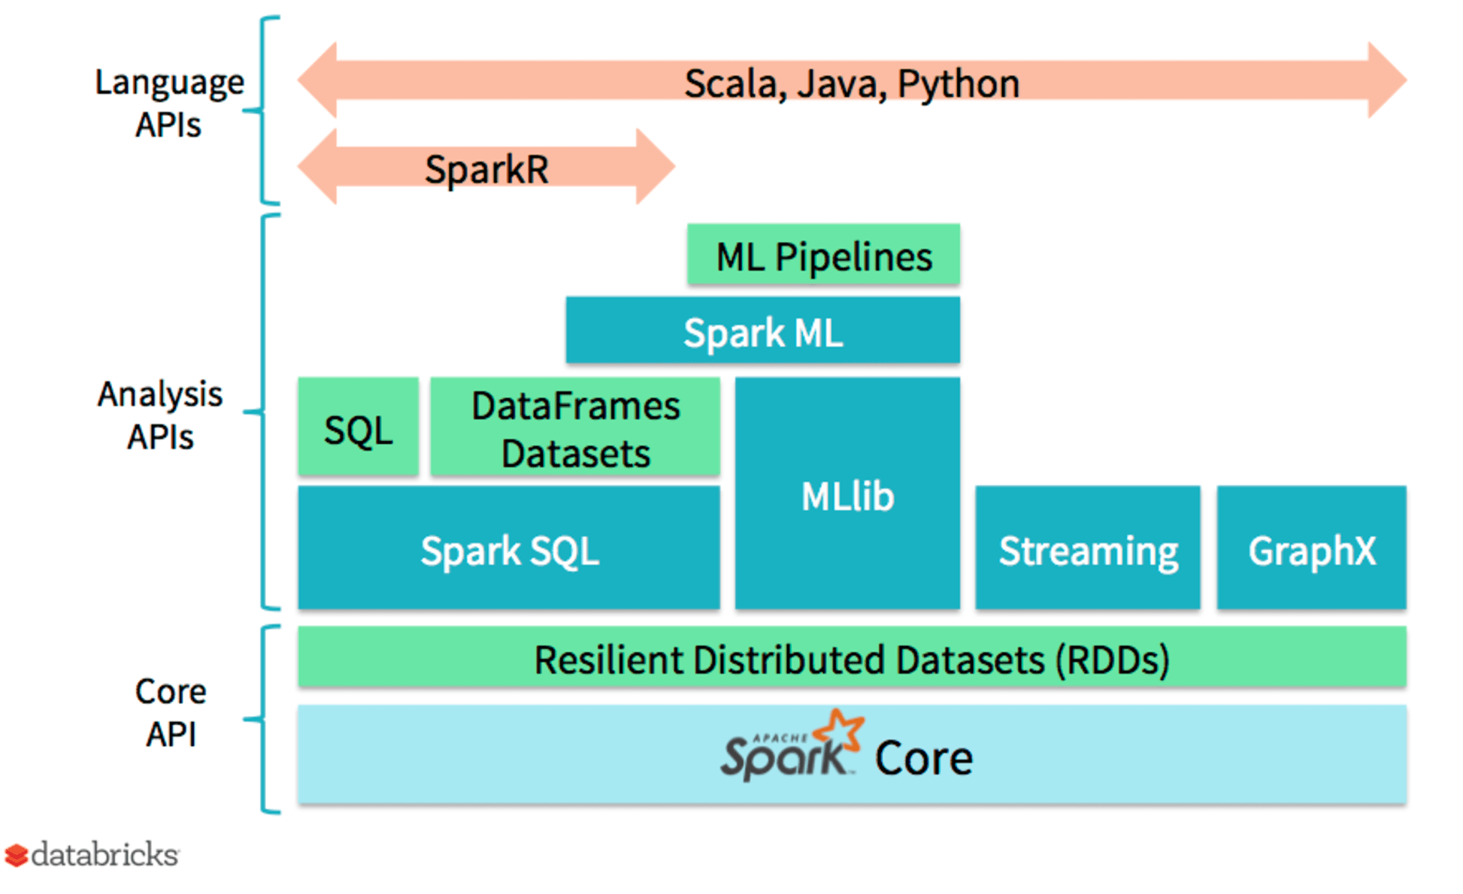
SparkR – What Do We Get?
Increased Support with Releases
https://databricks.com/blog/2016/12/28/10-things-i-wish-i-knew-before-using-apache-sparkr.html

Slide 18
Scaling Machine Learning
Open Source Machine Learning Libraries Do Not Scale
Input Data Size Limits
Do Not Support Parallel Processing
Are Not Multithreaded

Slide 19
SparkR vs. SparklyR
SparkR Was First
SparklyR is focused on Data Wrangling using the TidyVerse
Both can be used but are not 100% interoperable.
https://github.com/rstudio/sparklyr/issues/502
https://spark.rstudio.com/

Slide 20
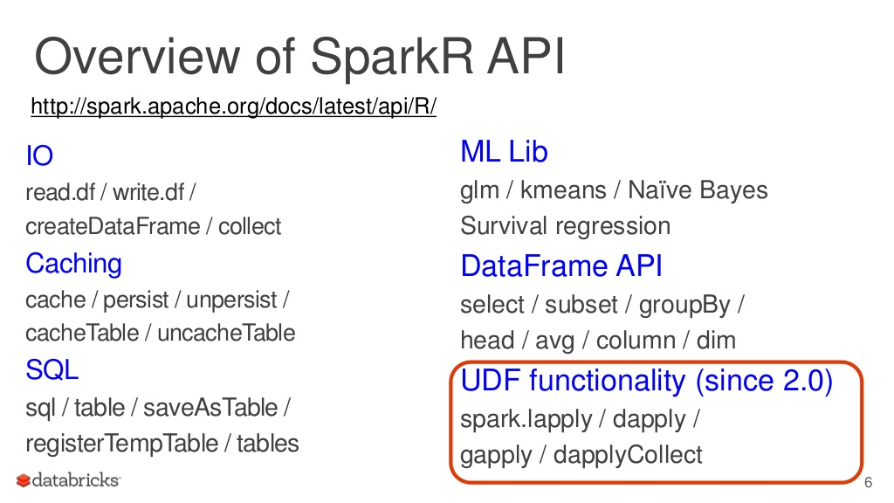
Apache Spark API
See Next Slide
https://www.slideshare.net/databricks/parallelizing-existing-r-packages-with-sparkr

Slide 21
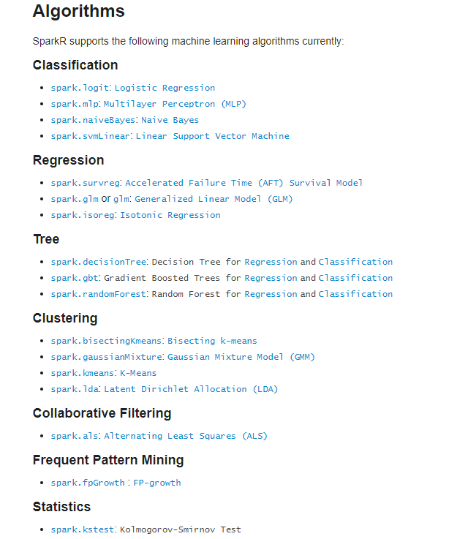

https://spark.apache.org/docs/latest/sparkr.html#machine-learning

Slide 22
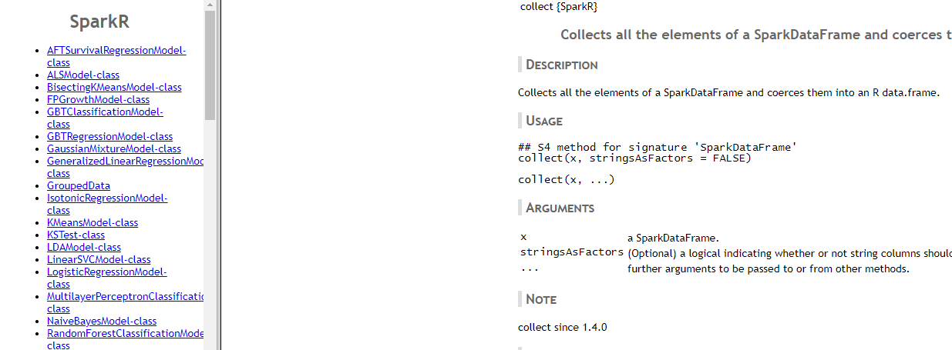
Apache SparkR Functions
https://spark.apache.org/docs/2.2.0/api/R/index.html

Slide 23
Azure Databricks R Language Deep Dive

Slide 24
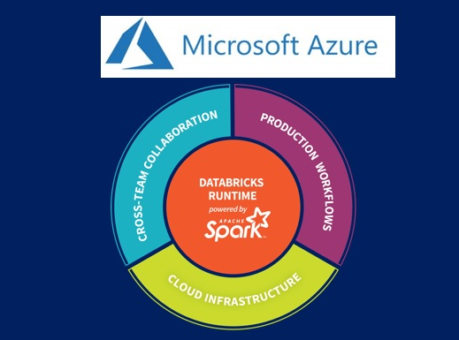
Azure Databricks R Deep Dive

